Slide 1
Course Wrap Up
Business Intelligence & Analytics

Slide 2
Definition 1: Delivering the right decision support to the right people at the right time.
People don’t buy drills; they buy holes
Drills
Holes
Ability to execute, monitor and control business processes
Provide insights to improve those processes
Notes:
A common discussion might start with technologies. In this space, you might hear about AWS at a conference

Slide 3
Ch1 | Failure not due to technology
It is particularly striking that 77% of respondents say that “business adoption” of big data and AI initiatives continues to represent a challenge for their organizations. This issue, and the low percentage of companies that have achieved data-driven organizations and cultures, suggests the need for a new focus. Respondents clearly say that technology isn’t the problem—people and (to a lesser extent) processes are.
Yet we would guess with high confidence that the great majority of spending on big data and AI goes for technology and its development. We hear little about initiatives devoted to changing human attitudes and behaviors around data. Unless the focus shifts to these types of activities, we are likely to see the same problem areas in the future that we’ve observed year after year in this survey. Let’s make the glass fuller.
-NVP Big Data and AI Executive Survey 2019

Slide 4
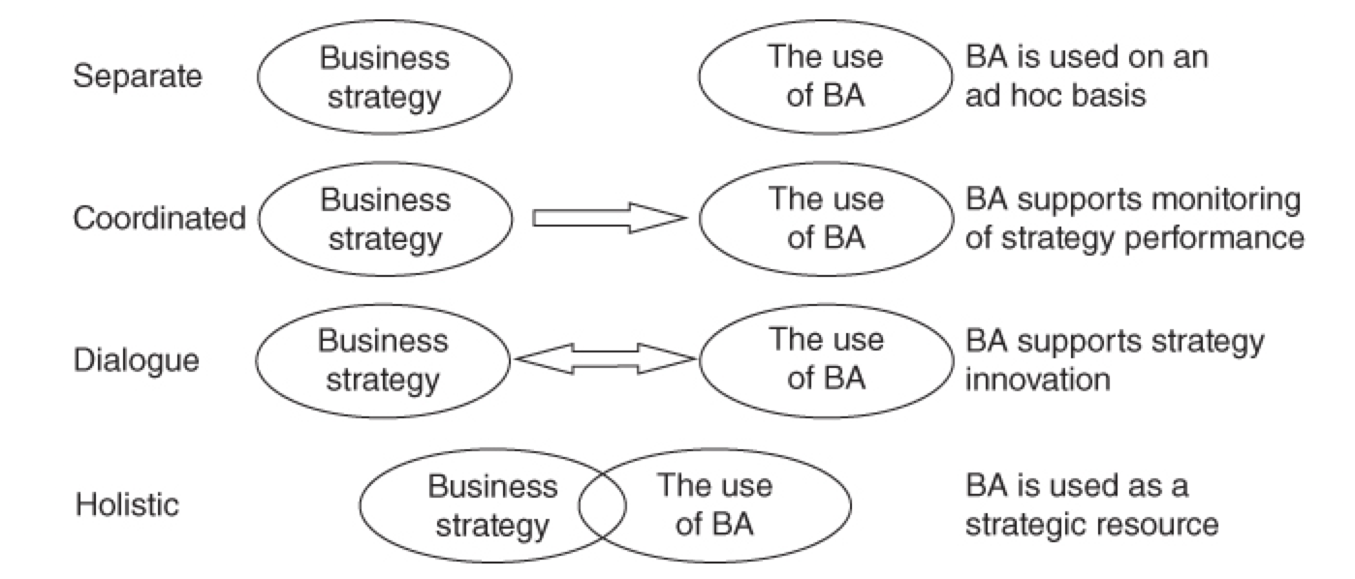
Ch2 | Integrating BA and strategy
Four scenarios represent maturity, ability and willingness to work with information at different levels.
Differences not a matter of “good” to “bad”
Option exists to take steps toward next phase or move to a strategy that is less dependent on information.

Slide 5
 | 1. Separate | 2. Coordinated | 3. Dialogue | 4. Holistic
Link to strategy | BA used only on an ad hoc basis | BA Supports monitoring performance | Feedback between strategy and BA | BA used as strategic resource
Quality | Measured as a function of how quickly requests are answered | Accuracy of target measurement | Based on ability to deliver relevant information to strategy function | Ability to provide the business a competitive advantage
Coordination between functions | None | Likely very little | Clear responsibility for individual metrics, regular meetings to coordinate activities | Information flow between departments and levels
Analytics work | Filling ad hoc requests | Creating dashboards | Reporting reasons for deviation from targets | Self-identified projects that provide competitive advantage

Slide 6
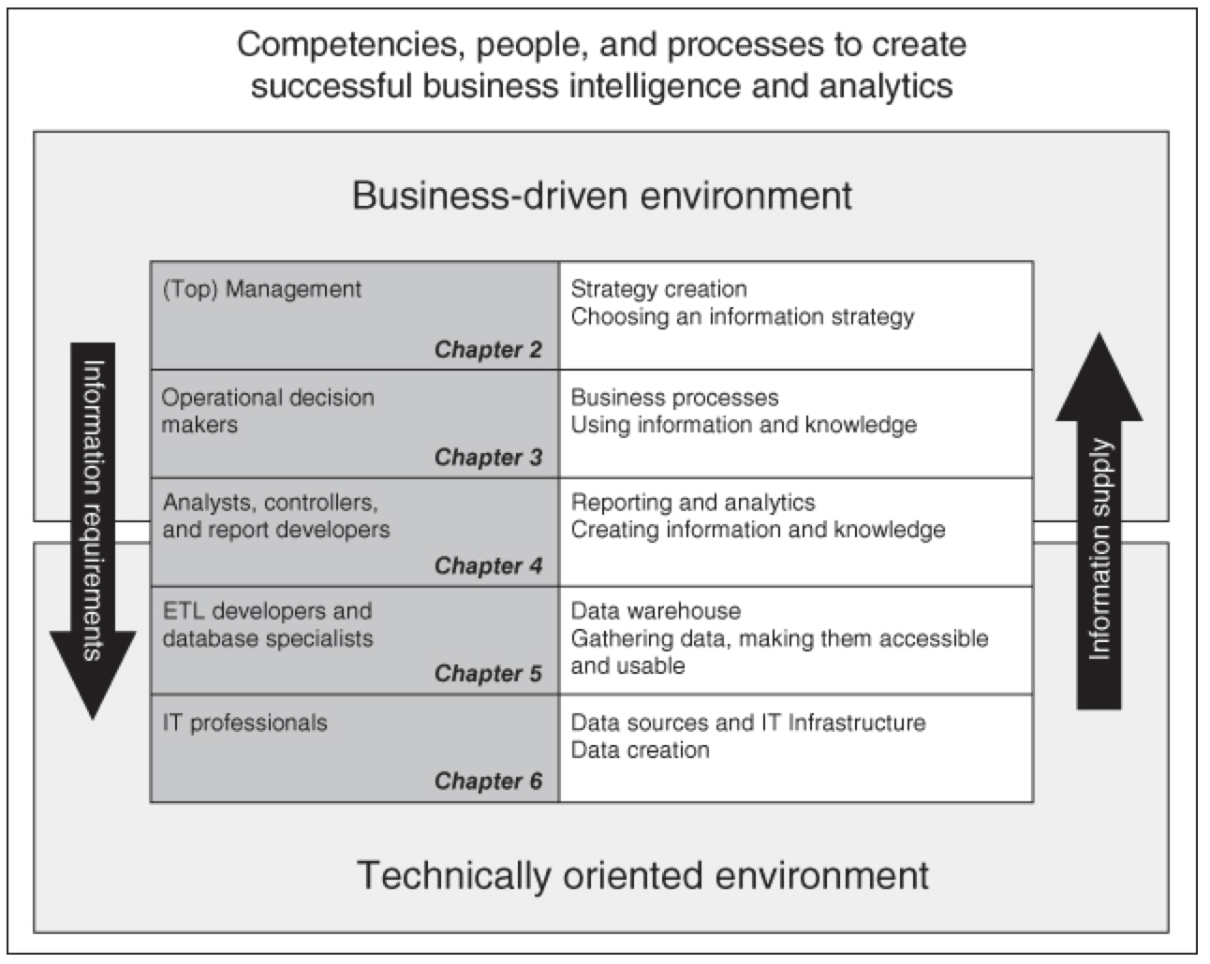
Ch2 | Business analytics model

Slide 7


Ch2 | Lead vs lag – planning first trip
The first time we do the trip, we need lead information to determine a route and decide when to leave. There’s no other way to get this data.

Slide 8
Ch3 | Lag data collected during trips
Lag Data
Trip 1 – minute-by-minute log
Trip 2 – minute-by-minute log
Trip 3 – minute-by-minute log
Trip 4 – minute-by-minute log
…
Trip N – minute-by-minute log

Slide 9
Ch3 | Lag used to generate lead info
Lag Data
Trip 1 – minute-by-minute log
Trip 2 – minute-by-minute log
Trip 3 – minute-by-minute log
Trip 4 – minute-by-minute log
…
Trip N – minute-by-minute log
What time should we leave?
What happens if we take a different route?
Where can we stop along the way?
How can we use less gas?
What is the fastest trip time?

Slide 10
Ch3 | Different types of information
Strategic Information
Definition: Information that would be used to create a digital marketing strategy.
Example: Should sales turnover be supported through new customer acquisition, selling more to existing customers or focusing on customer retention?
More generally: What should we do?
Tactical Information
Definition : Creation and optimization of new/existing campaigns.
Example: Who should receive this campaign? When should we introduce it? Should the campaign be time limited?
More generally: How should we do it?
Operational Information
Definition : Concrete information that will drive action against campaigns.
Example: Which customers should we contact and which offers should be made?
More generally: Support action.

Slide 11
Ch4 | data
Carrier of information
Too specific to be used for decision support
Not structured to make sense – could make sense in many contexts

Slide 12
Ch4 | information
Aggregated to a level where it makes sense
Includes reports, tables or lists

Slide 13
Ch4 | knowledge
Information interpreted
If a table is used, it is delivered with a summary or presentation of that it means in relation to business objectives
Not a result of automation
Requires analysts, quantitative methods and business insight

Slide 14
CH4 | Analysts role
Link the technical environment with the business environment
Ensure business value can be extracted from the technical environment
Then extract that value

Slide 15
Ch4 | Three requirements
Business competencies
Tool kit that is in order (method competencies)
Technical understanding (data competencies)

Slide 16
Ch5 | What is a data warehouse?
Data sources
Front-end Reporting System
ETL
Data Warehouse

Slide 17
Ch5 | Data warehouse notes
Data warehouse consists of two parts:
Technical – must ensure the company’s data is collected from its source systems and that it is stored, combined, structured and cleansed regardless of source system
Business – must ensure the desired key figures and reports can be created

Slide 18
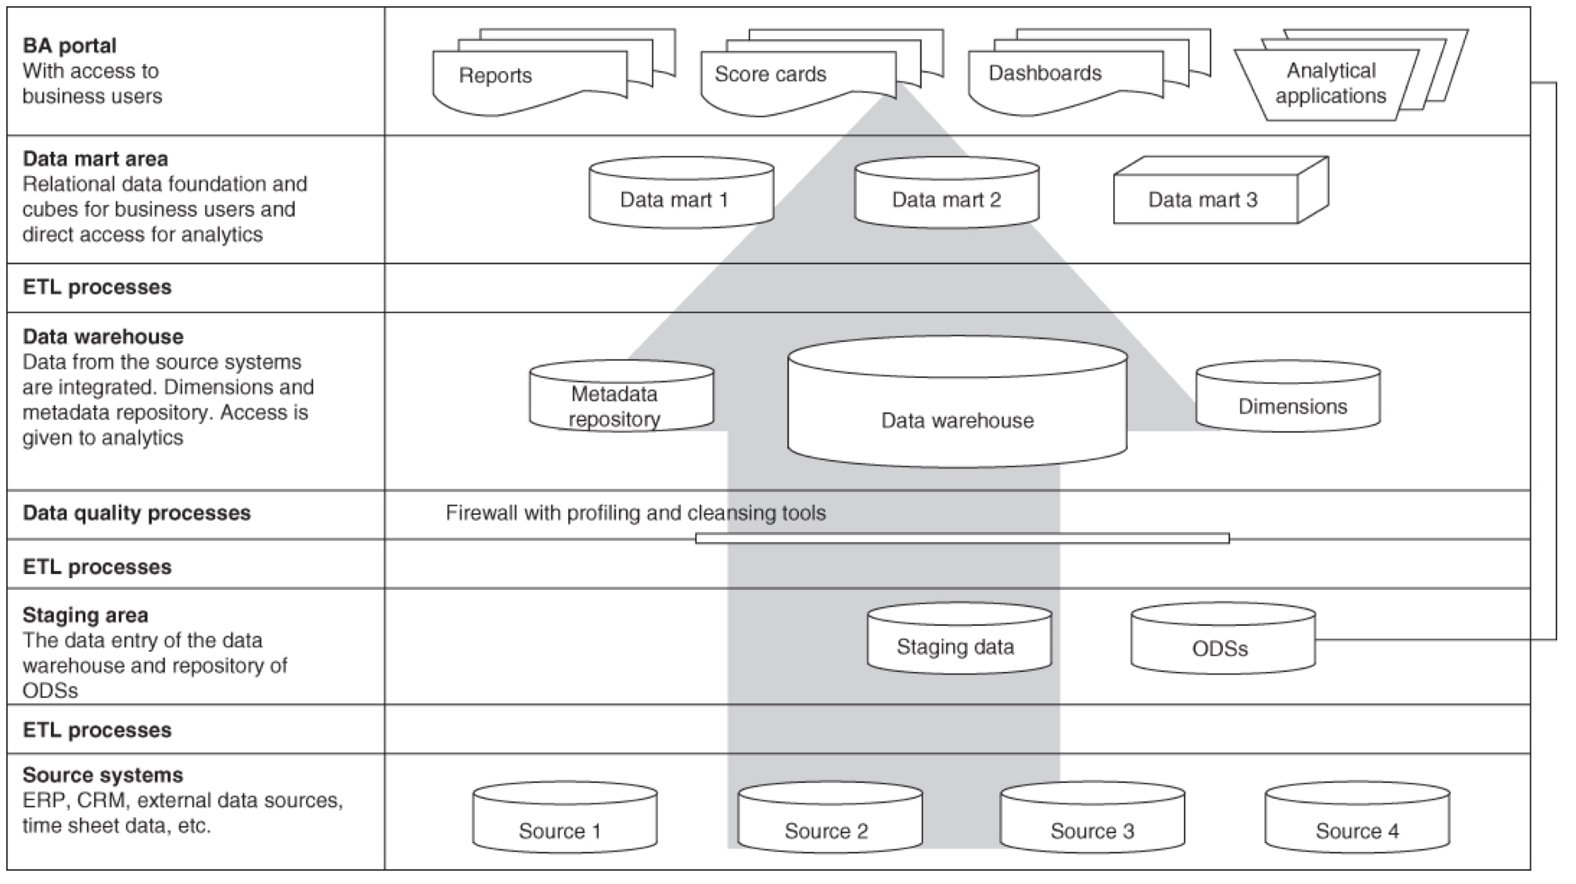
CH5 | How data moves in a dw

Slide 19
Ch5 | Kitty litter principle
Your data is like kitty litter…
Important to have as many people looking in the cat box as possible
Data quality is the responsibility of all employees
Data quality issues should be expected
Data quality issues should be fixed as quickly as possible

Slide 20
Ch6 | What is a source system?
Source System
Data sources on which a data warehouse is based
Many times there are several data warehouses integrated in such a way that one data warehouse can serve as a source system for another
Data-generating System
Systems that create data the first time
Many are front-end operational systems
Not in the data warehouse
Notes:
Checkout register as an example

Slide 21
External Analysts
Typically work with questionnaires or focus groups
Often leveraging external agencies that specialize in different analyses
Internal staff then focus on making sure the project meets objectives
And focus on communicating results
Projects will generally take months to complete
Can be quite expensive to run these projects but other data may not yield the same level of insight
Internal Analysts
Typically work with data stored in the data warehouse
Will likely be part of an internal analytics team
Projects range from weeks to months
Relatively inexpensive since the data is generally stored in the data warehouse anyway
Results can be implemented directly in the data warehouse when completed
Marketing Department
IT or Operations

Slide 22
Ch7 | Why create BACC
A voice that can be heard throughout the organization
Two ways this can happen
Give the manager of the BACC formal influence on management forums
Create synergies at the functional level
Create an ongoing dialogue for the improvement of the business
Solutions can be shared across departments and functions

Slide 23
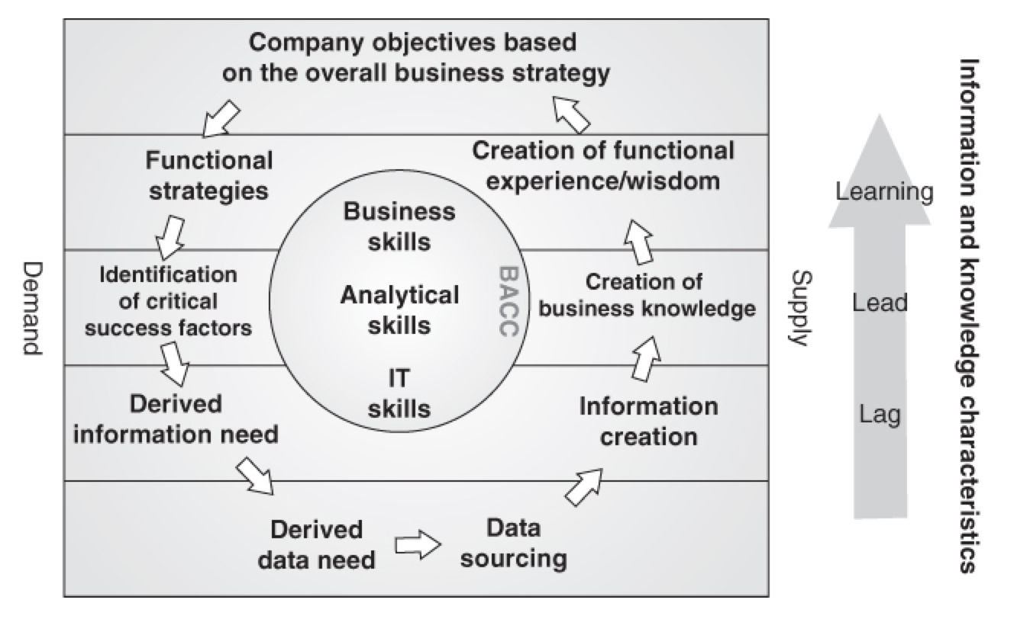
Ch7 | The information wheel
Notes
The Information Wheel describes the process of providing analytics to the business
Note that it is not always a cycle as shown, many projects finish with no follow up
Shows that the BACC lies at the center of what is provided
The BACC can be a dedicated team or can be decentralized (more on this later)

Slide 24
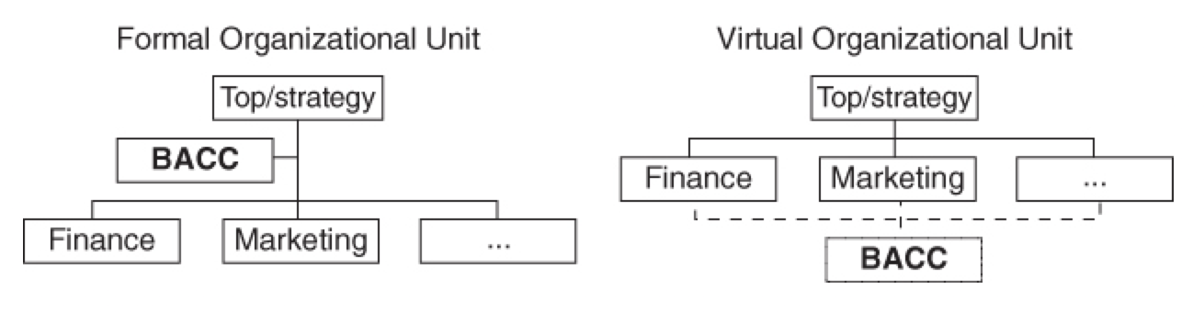
BACC organizational strategies
BACC set up as an organizational support unit
Generally reports directly to the strategic function of the business
BACC established as a virtual organization
Smaller strategic roll
Primarily setup to function at an operational level
Should facilitate synergies at the departmental level
What are we trying to achieve?

Slide 25
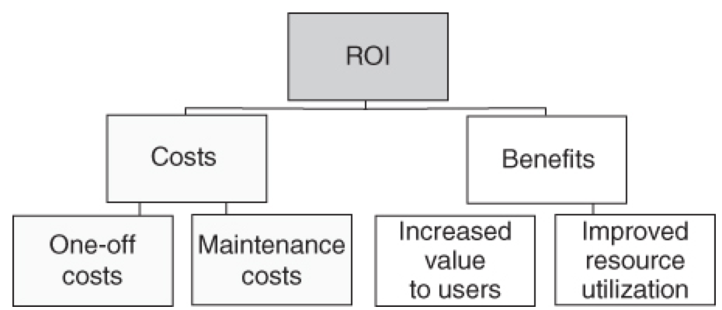
Ch8 | Further breakdown ROI
Notes
Rarely only incur one-off costs
Generally will be some increase to the cost of current operations or other costs (additional software purchases)
Benefits can be for the business (internal users) or for customers (external users)
Benefits could come in the form of better using existing resources

Slide 26
Ch8 | BA Mantra
Think big, start small, and deliver fast
Be ambitious
Break big idea into smaller chunks
Make solid plans for what to deliver and when

Slide 27
Keep in touch!
LI: https://www.linkedin.com/in/jeremydmorris/
Twitter: @seedatarun

Slide 28


